Slide 1

Overview on Futuristic IT Technology & ^{Cyber Security}
^{TOPIC:}
COURSE: CCC Concepts
CHAPTER: 09 (Overview on Futuristic IT Technology & Cyber Security)
DAY: 47
NIELIT
Presented By: Shruti Dubey

Slide 2
Goals of Information Security
The aim of information security is to develop and maintain a security plan to protect the information.
Three main goals of Information security are:
Detection: The most important element of this strategy is timely detection and notification of a compromise. Intrusion detection systems (IDS) are utilized for this purpose.
Prevention: Security measures must be taken to protect information from unauthorized modification, destruction, or disclosure whether accidental or intentional.
Response: Making important decisions or developing policy while under attack is a recipe for disaster.

Slide 3
Securing an Operating System (Windows 10)
Personal Computer security is the process of preventing and detecting unauthorized use of personal computer.
Prevention measures help user to stop unauthorized users (hackers) from accessing any part of their computer system.
Detection helps user to determine whether or not someone attempted to break security into their system. PC security is considered to be more important for the following reasons:
To prevent data theft
To prevent theft or destruction to hardware
To prevent any software or service getting disrupted

Slide 4
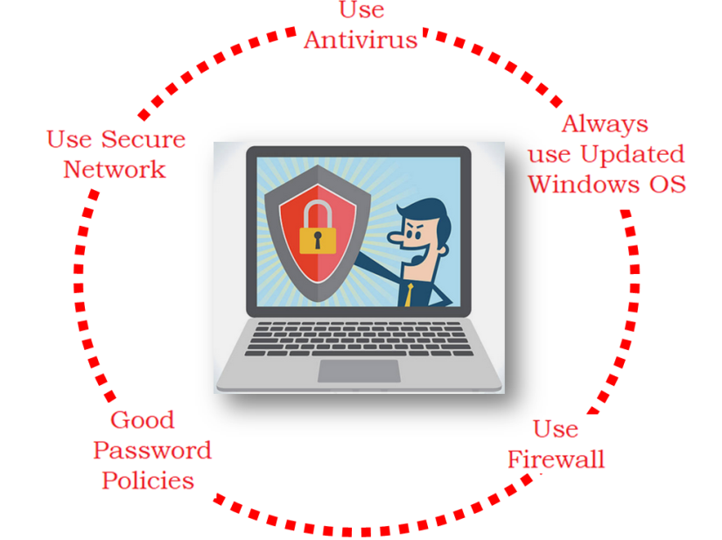
Securing an Operating System (Windows 10)
For securing the Personal Computer, use the following Instructions:
Always use Updated Windows OS.
Use of Antivirus.
Use of Secure Network.
Good Password Policies.
Use of firewall.

Slide 5
Updating Windows OS (windows 10)
Windows Update is a free Microsoft service that's used to provide updates like service packs and patches for the Windows operating system and other Microsoft software.
Windows Update can also be used to update drivers for popular hardware devices.
Windows Update is used to keep Microsoft Windows and several other Microsoft programs updated.
Updates often include feature enhancements and security updates to protect Windows from malware and malicious attacks.

Slide 6
Updating Windows OS
Windows Update's gives a number of important information:
Important Updates: Normally these are fixes for security issues, or to fix a problem that could cause system instability. They should be installed immediately.
Recommended Updates: These are often additional new features or functionality. It's a good idea, but not a necessity, to install them.
Optional Updates: These are often take-or-leave updates. They can be driver updates to help some devices work better with Windows or they could be trial software from Microsoft.

Slide 7
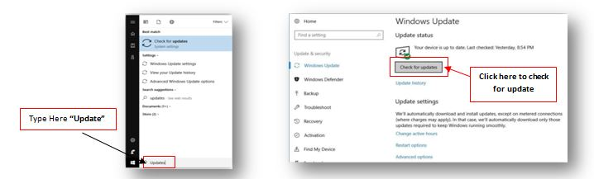
How to Get Updates in Windows 10
Click the Start menu and type “Updates” in the search bar and click “Check for updates” button.

Slide 8
Password Policies
In many operating systems, the most common method to authenticate a user's identity is to use a secret passphrase or password. A secure network environment requires all users to use strong passwords, which have at least eight characters and include a combination of letters, numbers, and symbols.
Windows supports fine-grained password policies. This feature provides organizations with a way to define different password and account lockout policies for different sets of users in a domain.
Enforce password history
Maximum password age
Minimum password age
Minimum password length
Password must meet complexity requirements
Store passwords using reversible encryption

Slide 9
User Account Policies
A user account policy is a document which outlines the requirements for requesting and maintaining an account on computer systems or networks, typically within an organization.
It is very important for large sites where users typically have accounts on many systems. Some sites have users read and sign an account policy as part of the account request process.
Account Policies contains three subsets:
Password Policy. These policy settings are used for domain or local user accounts. They determine settings for passwords, such as enforcement and lifetimes.
Account Lockout Policy. These policy settings are used for domain or local user accounts. They determine the circumstances and length of time that an account will be locked out of the system.

Slide 10
Create Multiple Users in Windows 10
Windows operating system gives the facility to create multi user, called “Guest user”. The benefit of this service is giving only limited rights to the guest user by the administrator to access their computer as well as files and resources.
To create a new user in Windows, please make sure logging in with an account that has administrator privileges, go to the Windows 10 Start Screen and type Add User, the search results appear click on the Settings category as shown in figure.
Now click on the option Give other users access to this computer, which would open the User Settings screen, Scroll down and click on the Add User option.

Slide 11
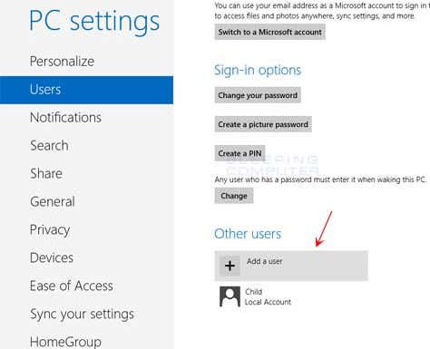
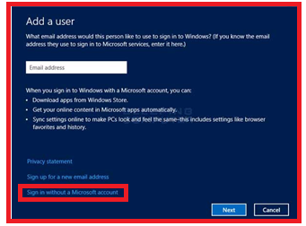
Create Multiple Users in Windows 10

Slide 12
Create Multiple Users in Windows 10
Screen prompting to enter the user's email address would be appearing.
By default, the above screen prompts to enter an email so that create a Microsoft account.
If user wishes to create a Microsoft account, enter email address and click on the Next button.
If user does not wish to use a Microsoft account, it should instead click on the Sign in without a Microsoft account option in the screen above.

Slide 13
Create Multiple Users in Windows 10 Contd..
A screen will appear where Windows will ask again if user is sure to wish to make a Local account.
Click on the Local account button and this will bring a new screen where need to input the information for the Local account.
At this screen needs to fill in the desired user name, password, and a hint that will be used to help user remember their password.
When it done filling in the information, please click on the Next button.

Slide 14
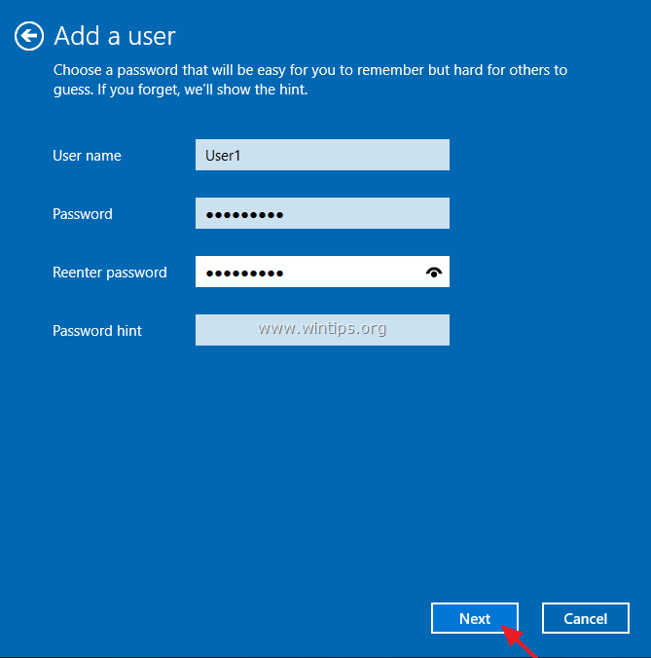
Create Multiple Users in Windows 10

Slide 15
Using Antivirus in Windows Operating System
What are Virus, Worm, and Malware?
Virus – A piece of code that is capable of copying itself and typically has a detrimental effect, such as corrupting a system or destroying data on an individual computer.
Virus is designed to spread from host to host and has the ability to replicate itself.
A computer virus operates by inserting or attaching itself to a legitimate program or document that supports macros in order to execute its code.
It also known as Threat.

Slide 16
How does a computer virus attack?
Once a virus has successfully attached to a program, file, or document, it will lie dormant until circumstances cause the computer or device to execute its code.
In order for a virus to infect computer, user have to run the infected program, which in turn causes the virus code to be executed.
However, once the virus infects computer, the virus can infect other computers on the same network.
A virus can do stealing passwords or data, logging keystrokes, corrupting files, spamming email contacts.

Slide 17
Worm
A computer worm is a standalone malware computer program that replicates itself and spread to other computers.
Often, it simply clones itself over and over again and spreads
via a network (say, the Internet, a local area network at home,
or a company’s intranet) to other systems where it continues to replicate itself.

Slide 18
Thank you! If you have any query, please contact:
NIELIT
www.nielit.gov.in/haridwar

